Slide 1
Figures – Chapter 23

Slide 2
Figure 23.1 Factors affecting software pricing
Factor | Description
Market opportunity | A development organization may quote a low price because it wishes to move into a new segment of the software market. Accepting a low profit on one project may give the organization the opportunity to make a greater profit later. The experience gained may also help it develop new products.
Cost estimate uncertainty | If an organization is unsure of its cost estimate, it may increase its price by a contingency over and above its normal profit.
Contractual terms | A customer may be willing to allow the developer to retain ownership of the source code and reuse it in other projects. The price charged may then be less than if the software source code is handed over to the customer.
Requirements volatility | If the requirements are likely to change, an organization may lower its price to win a contract. After the contract is awarded, high prices can be charged for changes to the requirements.
Financial health | Developers in financial difficulty may lower their price to gain a contract. It is better to make a smaller than normal profit or break even than to go out of business. Cash flow is more important than profit in difficult economic times.

Slide 3
Figure 23.2 Project plan supplements
Plan | Description
Quality plan | Describes the quality procedures and standards that will be used in a project.
Validation plan | Describes the approach, resources, and schedule used for system validation.
Configuration management plan | Describes the configuration management procedures and structures to be used.
Maintenance plan | Predicts the maintenance requirements, costs, and effort.
Staff development plan | Describes how the skills and experience of the project team members will be developed.

Slide 4
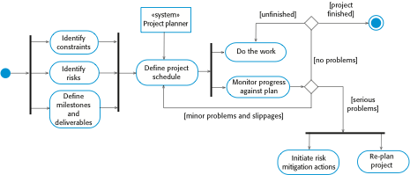
Figure 23.3 The project planning process

Slide 5

Figure 23.4 The project scheduling process

Slide 6
Figure 23.5 Tasks, durations, and dependencies
Task | Effort (person-days) | Duration (days) | Dependencies
T1 | 15 | 10
T2 | 8 | 15
T3 | 20 | 15 | T1 (M1)
T4 | 5 | 10
T5 | 5 | 10 | T2, T4 (M3)
T6 | 10 | 5 | T1, T2 (M4)
T7 | 25 | 20 | T1 (M1)
T8 | 75 | 25 | T4 (M2)
T9 | 10 | 15 | T3, T6 (M5)
T10 | 20 | 15 | T7, T8 (M6)
T11 | 10 | 10 | T9 (M7)
T12 | 20 | 10 | T10, T11 (M8)

Slide 7
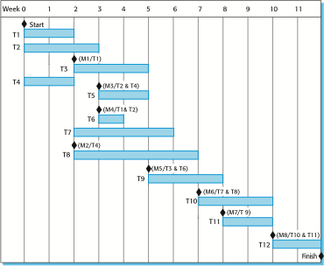
Figure 23.6 Activity bar chart

Slide 8
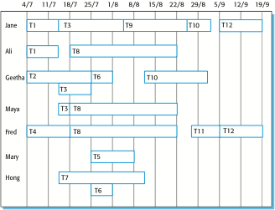
Figure 23.7 Staff allocation chart

Slide 9

Figure 23.8 Planning in XP

Slide 10
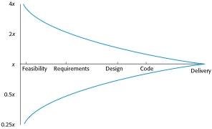
Figure 23.9 Estimate uncertainty

Slide 11
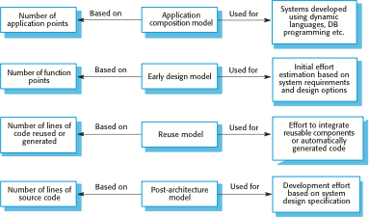
Figure 23.10 COCOMO estimation models

Slide 12
Figure 23.11 Application-point productivity
Developer’s experience and capability | Very low | Low | Nominal | High | Very high
ICASE maturity and capability | Very low | Low | Nominal | High | Very high
PROD (NAP/month) | 4 | 7 | 13 | 25 | 50

Slide 13
Figure 23.12 Scale factors used in the exponent computation in the post-architecture model
Scale factor | Explanation
Precedentedness | Reflects the previous experience of the organization with this type of project. Very low means no previous experience; extra-high means that the organization is completely familiar with this application domain.
Development flexibility | Reflects the degree of flexibility in the development process. Very low means a prescribed process is used; extra-high means that the client sets only general goals.
Architecture/risk resolution | Reflects the extent of risk analysis carried out. Very low means little analysis; extra-high means a complete and thorough risk analysis.
Team cohesion | Reflects how well the development team knows each other and work together. Very low means very difficult interactions; extra-high means an integrated and effective team with no communication problems.
Process maturity | Reflects the process maturity of the organization. The computation of this value depends on the CMM Maturity Questionnaire, but an estimate can be achieved by subtracting the CMM process maturity level from 5.

Slide 14
Figure 23.13 The effect of cost drivers on effort estimates
Exponent value | 1.17
System size (including factors for reuse and requirements volatility) | 128,000 DSI
Initial COCOMO estimate without cost drivers | 730 person-months
Reliability | Very high, multiplier = 1.39
Complexity | Very high, multiplier = 1.3
Memory constraint | High, multiplier = 1.21
Tool use | Low, multiplier = 1.12
Schedule | Accelerated, multiplier = 1.29
Adjusted COCOMO estimate | 2,306 person-months
Reliability | Very low, multiplier = 0.75
Complexity | Very low, multiplier = 0.75
Memory constraint | None, multiplier = 1
Tool use | Very high, multiplier = 0.72
Schedule | Normal, multiplier = 1
Adjusted COCOMO estimate | 295 person-months

Slide 15
Figure 23.14 Scheduling example
Task | Duration | Dependencies
T1 | 10
T2 | 15 | T1
T3 | 10 | T1, T2
T4 | 20
T5 | 10
T6 | 15 | T3, T4
T7 | 20 | T3
T8 | 35 | T7
T9 | 15 | T6
T10 | 5 | T5, T9
T11 | 10 | T9
T12 | 20 | T10
T13 | 35 | T3, T4
T14 | 10 | T8, T9
T15 | 20 | T12, T14
T16 | 10 | T15

